Slide 1
3 card poker
No Gambling $10 for $10 gift card for even money + free gift!
foot-in-the-door for sales of Artist's original paintings, prints, post cards, commission the artist, Portraits, small portrait, Paint your car, Christmas lights, ornaments, Christmas light plants, No Sewing Designer Scarf Wear! Designer's Jeweled bags, etc.!

Slide 2
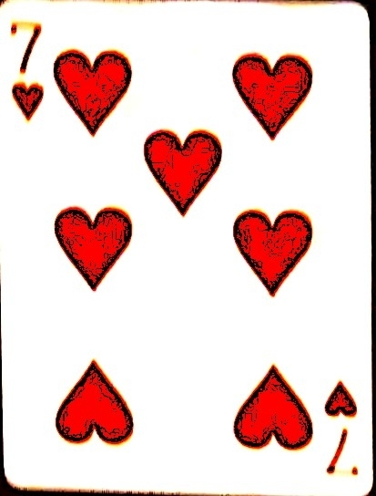
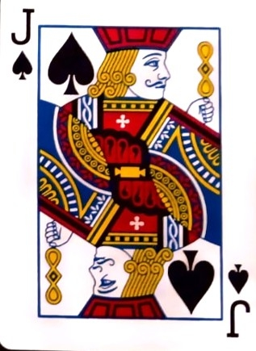
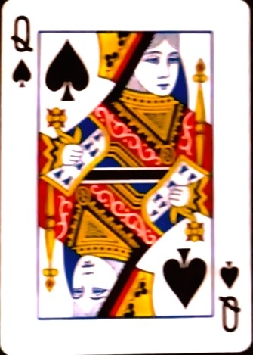
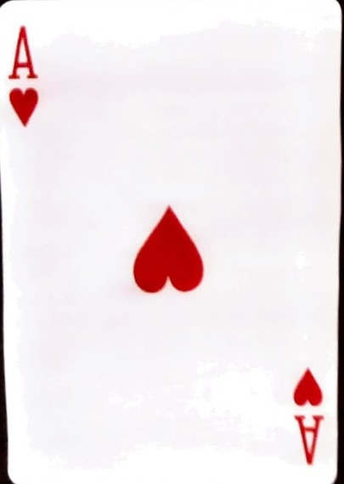
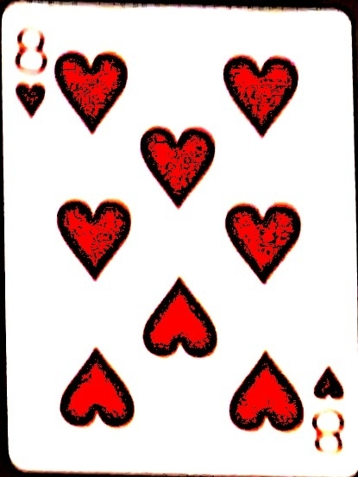
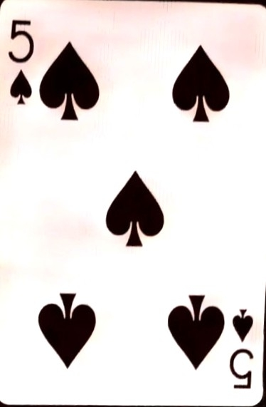
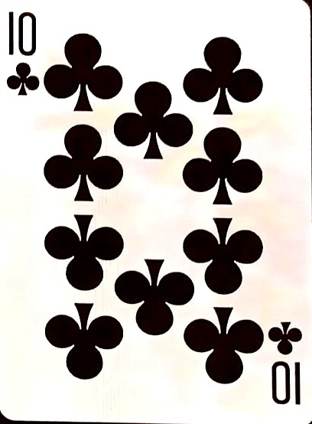
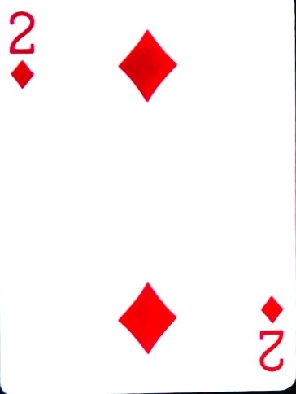
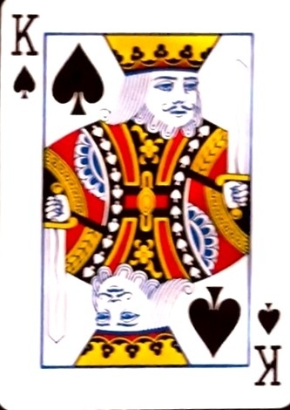
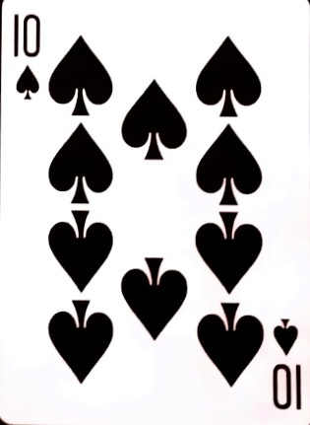
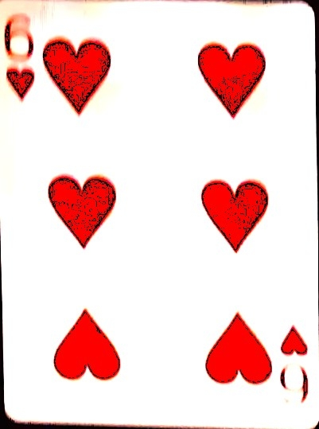
3 card poker
Player1 Wins w
flush
Pick A Player
1
2
3

Slide 3
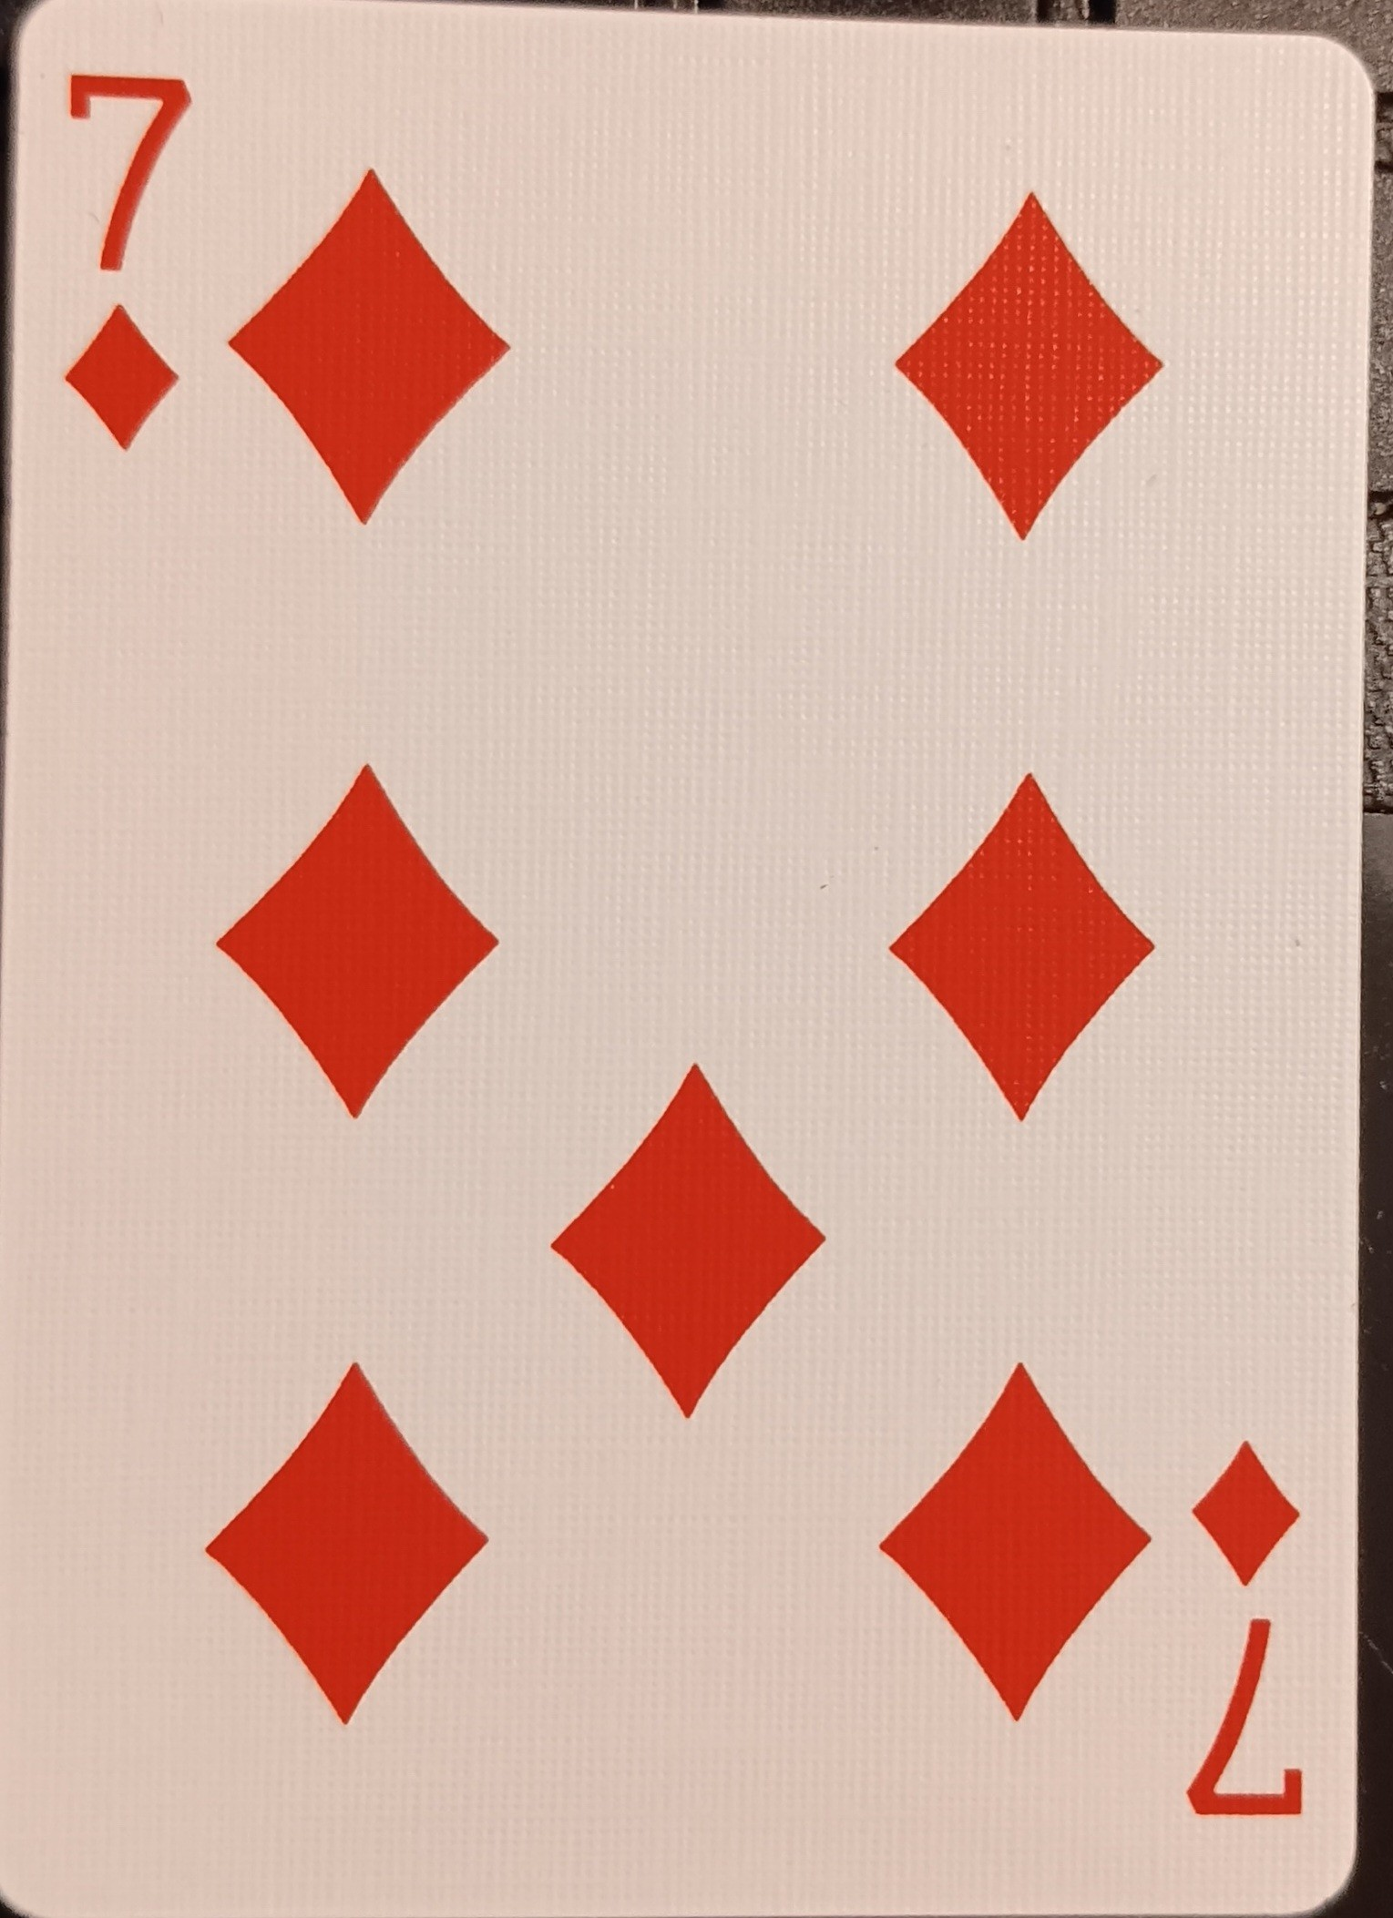
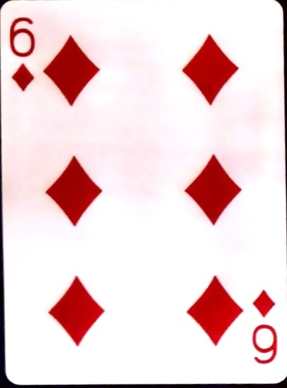
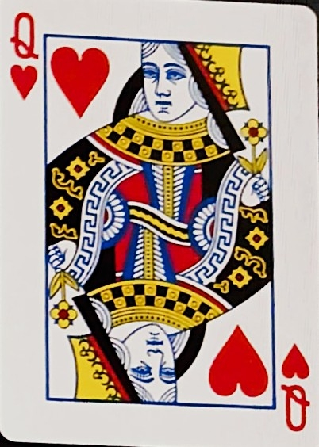
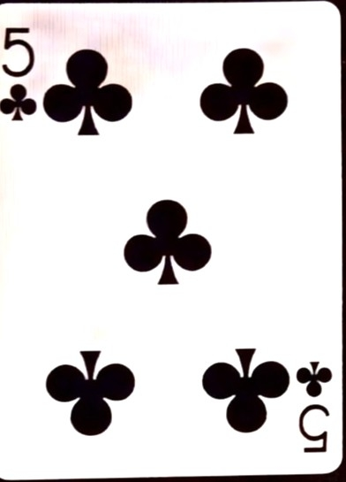
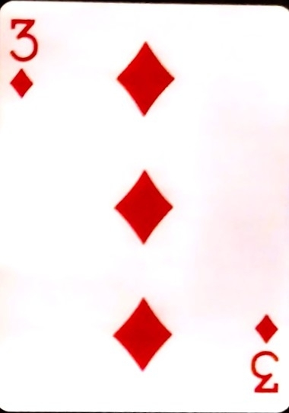
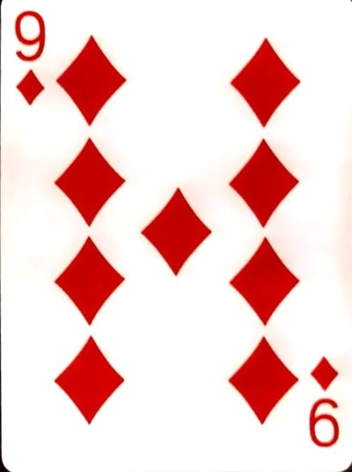
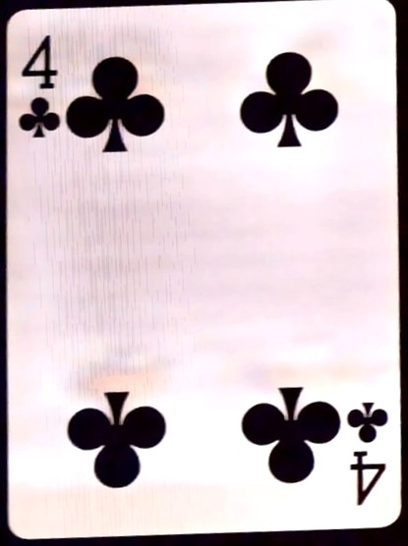
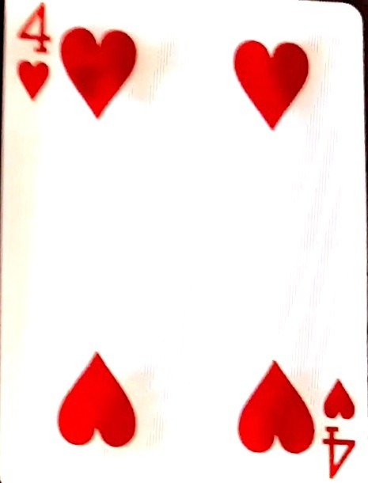
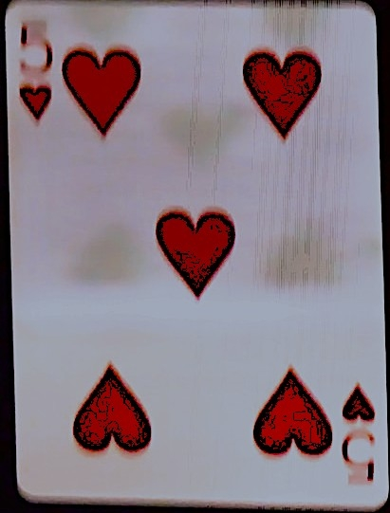
3 Card Poker
Player 2
with a
Straight Wins!

Slide 4
Payouts
Straight flush 40 times
3 of a kind 30 times
straight 6 times
flush 3 times & Pair 1 time

Slide 5
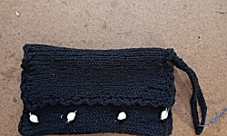
Win Even Money + A book
Win a prize Real Pearls Black Purse $90. Or just play for fun and purchase!

Slide 6
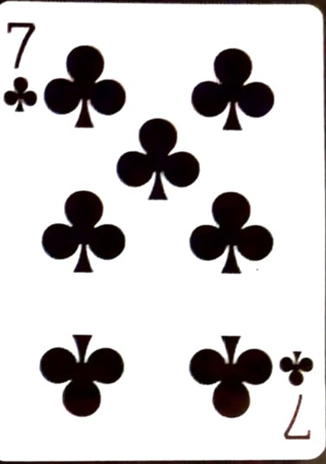
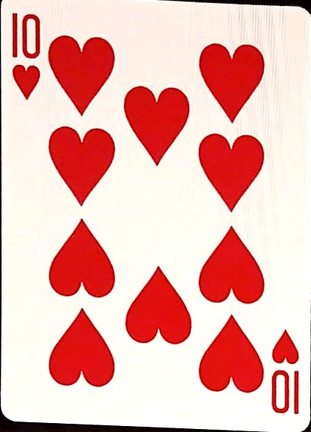
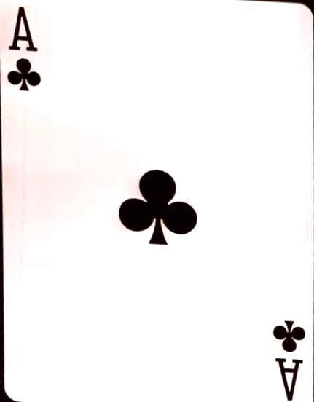
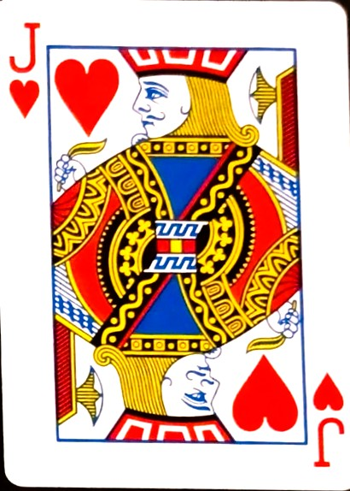
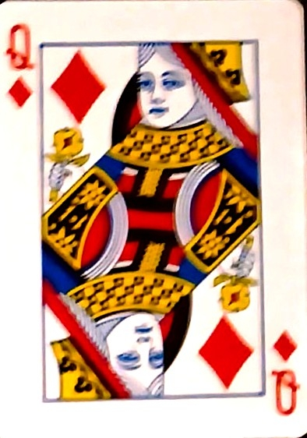
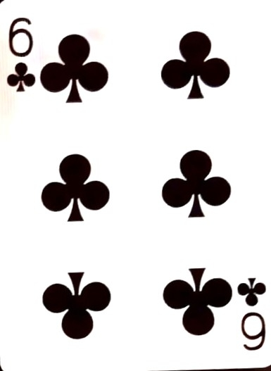
3 Card Poker
Player 1
With a Pair Won

Slide 7
3 Card Poker
Player 1
With a Pair Won

Slide 8
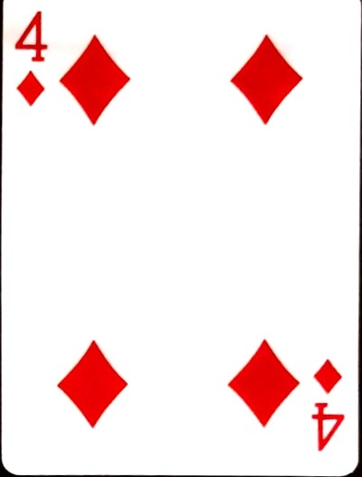
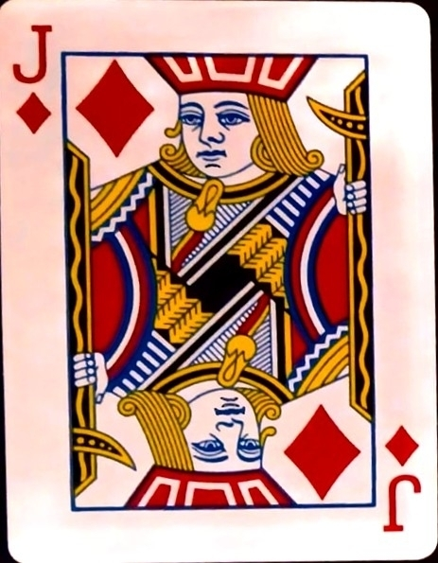
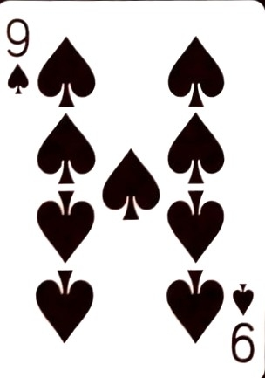
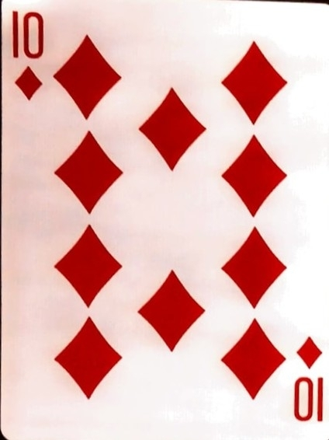
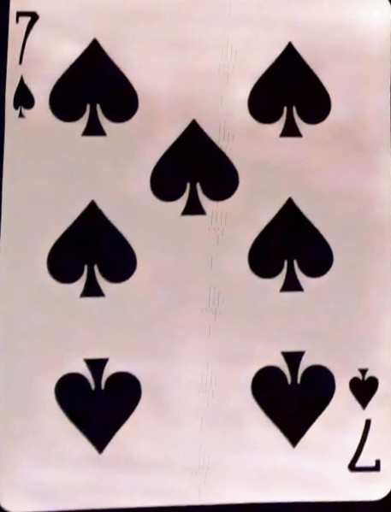
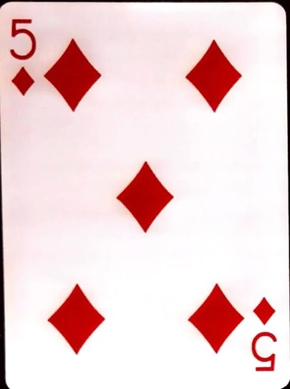
3 Card Poker
Dealer
Has Flush
Pick a
Player
2
3
1

Slide 9
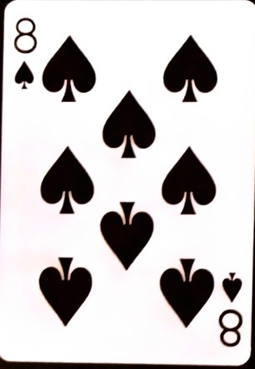
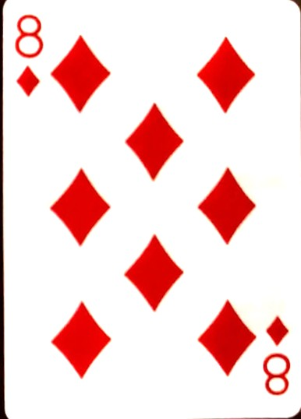
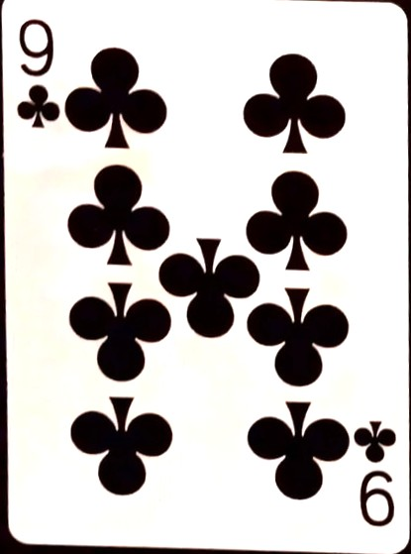
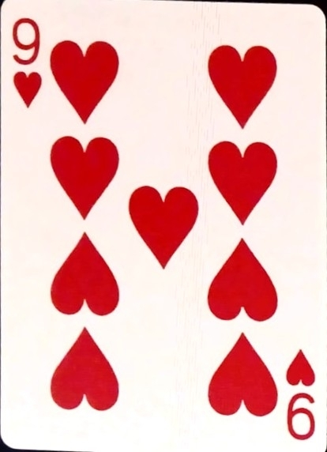
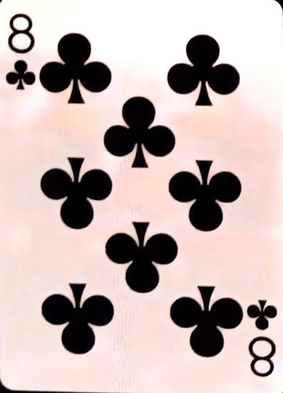
3 Card Poker
Players 1 & 2 with pairs wins!

Slide 10
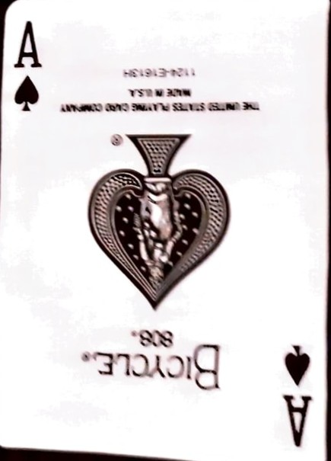
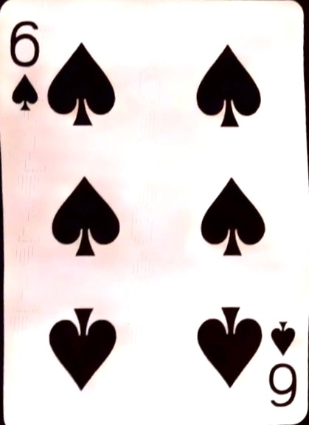
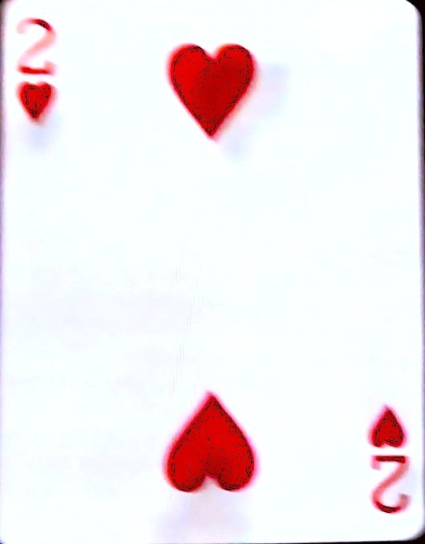
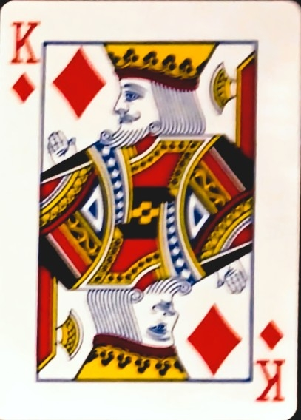
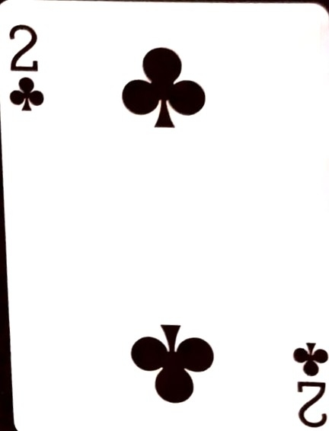
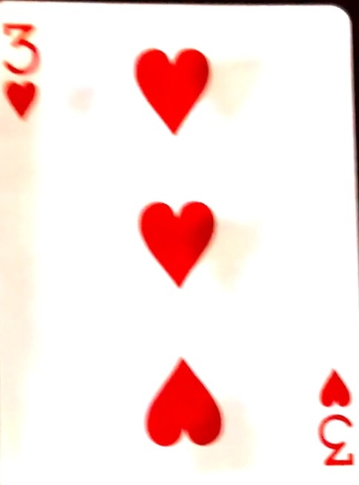
3 Card Poker
Player 2 with a pair wins!

Slide 11
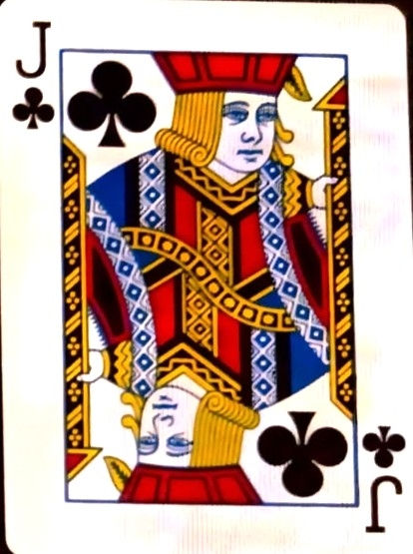
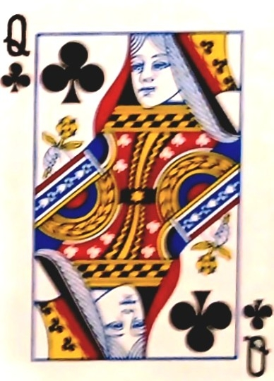
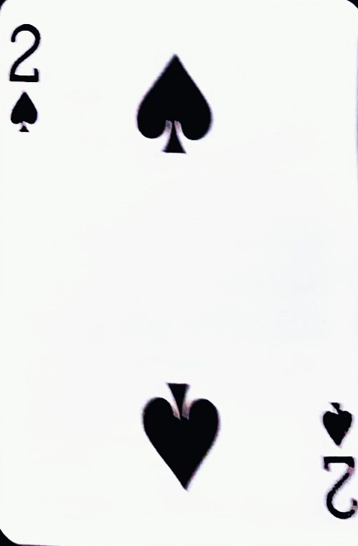
3 Card Poker
Player 1
Wins with a Pair

Slide 12
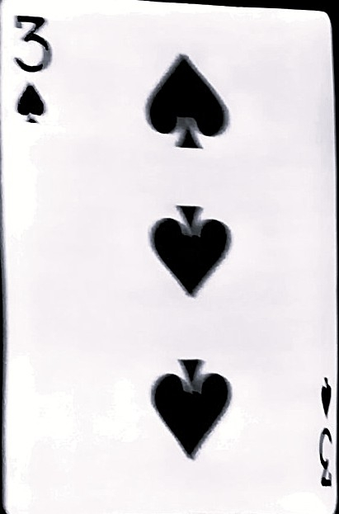
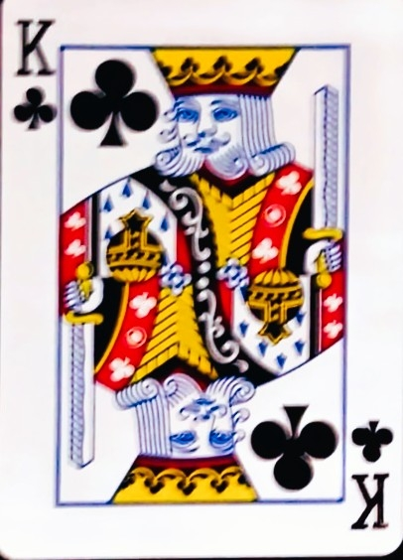
3 Card Poker
Player 3 wins with
a pair

Slide 13
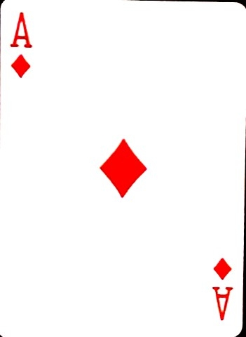
3 card poker

Slide 14


3 card poker
Player 1 wins
with a pair

Slide 15

3 card poker
Dealer has a pair

Slide 16
3 card poker
Player 1 w flush &
player 2 w a straight, player 3 has a pair WINs
Dealer
Pick a player
3
1
2

Slide 17






No Gambling Play $10 to Win $10 Gift Card + win prizes!
$10 Grab Bag worth more! Artist's Stuff, Books, Free gifts,T-shirt. Just play for fun and purchase! Artist's Gift bag, Designer & Christmas stuff! Post cards, prints, small portraits & more!
Original Paintings,Scarf Wear, Books,Tables, bars

Slide 18

3 card poker
player 3 has a pair win!

Slide 19
3 card poker
player 1 has a pair

Slide 20
3 card poker

Slide 21

3 card poker

Slide 22
3 card poker

Slide 23
3 card poker
Dealer has a pair

Slide 24
3 card poker
Player 1 has a Flush Wins!

Slide 25
3 card poker
Player1 has a pair Wins!

Slide 26
Flying Slots!
won 2,000 coins!
Play Flying Slots!
$
$
7
7
$
$
$
$
1,000 coins
-
$
$
$
$
1,0000 Coins

